Slide 1
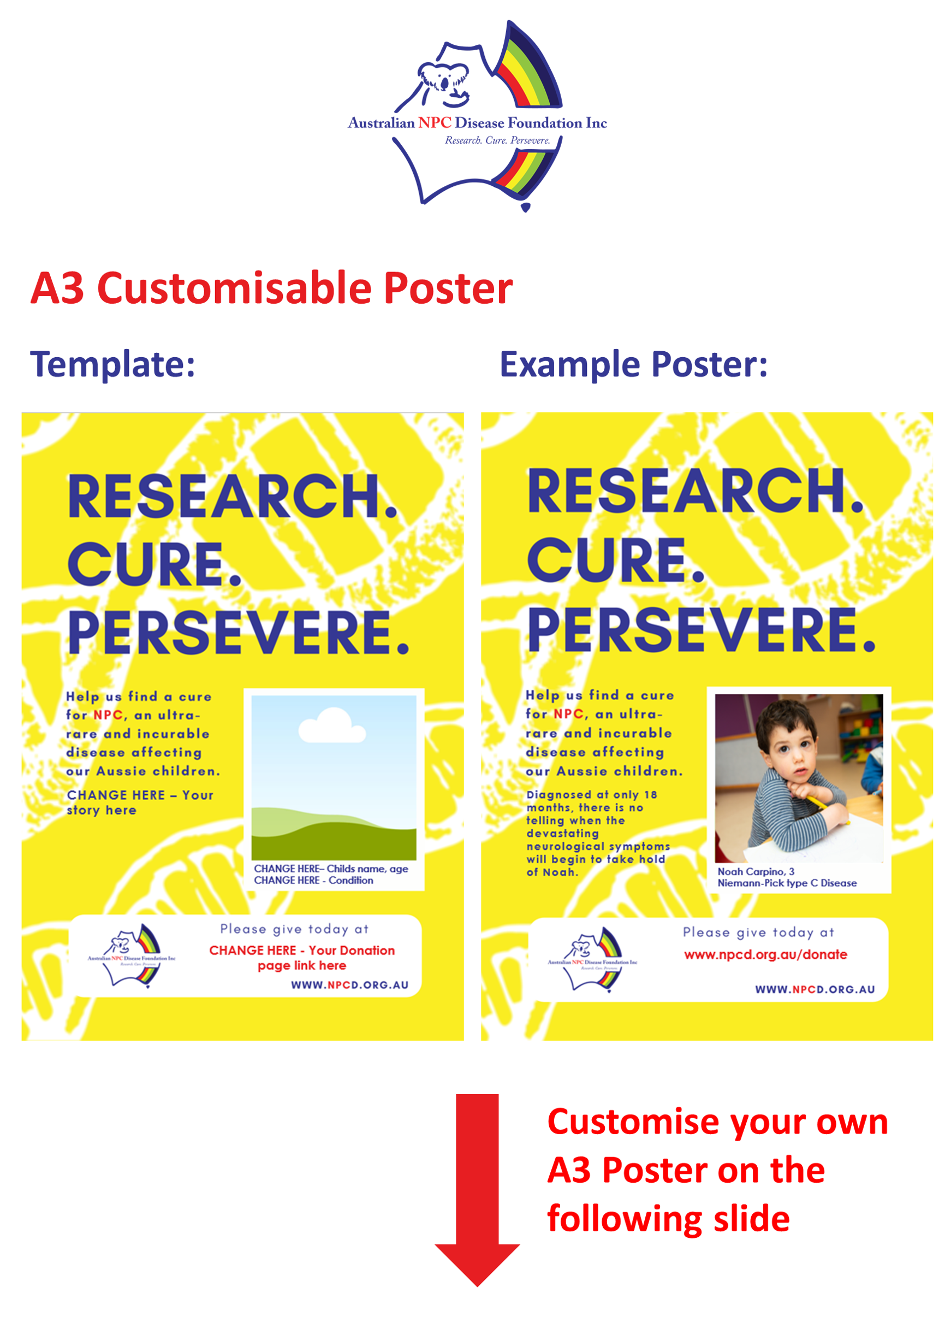

Slide 2

Your child’s
picture here
CHANGE HERE – Your story here
CHANGE HERE– Childs name, age
Niemann Pick type C disease
CHANGE HERE - Your Donation page link here

Slide 3

00,000.00
Your child’s
picture here
CHANGE HERE– Childs name, age
Niemann Pick type C disease

Slide 4

CHANGE HERE
Your child’s
picture here
CHANGE HERE– Childs name, age
Niemann Pick type C disease

